Slide 1

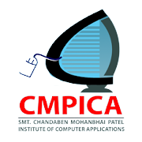
Pharmacy Management System
22MCA070 – Krish Moradiya
22MCA194 – Darshan Pansuriya

Slide 2
Index
Introduction
Tools ad Technologies used
Software & Hardware requirement
Major Functionality
Feasibility study
Limitations
Outcome
Future Enhancement
Bibliography

Slide 3
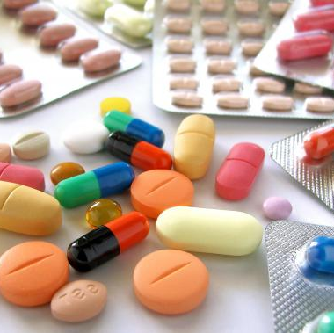
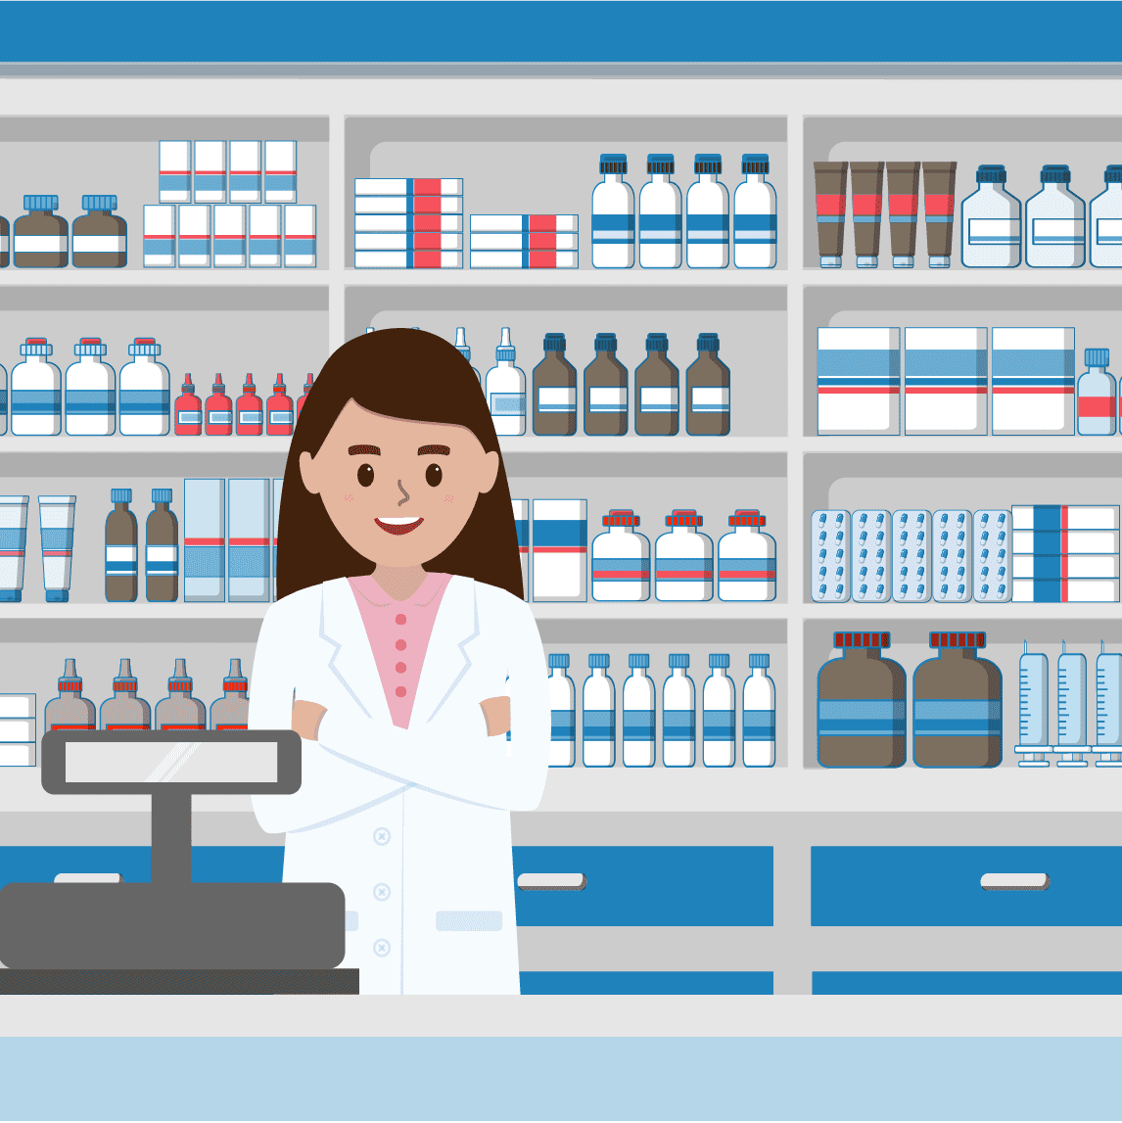
Introduction
A pharmacy management software is any system used in a pharmacy that helps automate the pharmacy workflow. This includes such tasks as reviewing physician orders and preparing medications, controlling the inventory and making drug orders, handling billing and insurance, providing counseling, identifying incompatibilities, and more all while following legal protocols and compliances.

Slide 4


TOOLS AND TECHNOLOGIES
JAVA
JAVA Servlet - Servlet technology is used to create a web application (resides at server side and generates a dynamic web page).
JAVA JSP - JSP technology is used to create web application just like Servlet technology. It can be thought of as an extension to Servlet because it provides more functionality than servlet such as expression language, JSTL, etc.
MySQL database
MySQL is a relational database management system based on the Structured Query Language, which is the popular language for accessing and managing the records in the database. MySQL is open-source and free software under the GNU license.

Slide 5


NetBeans
NetBeans IDE is a free, open source, integrated development environment (IDE) that enables you to develop desktop, mobile and web applications. The IDE supports application development in various languages, including Java, HTML5, PHP and C++. The IDE provides integrated support for the complete development cycle, from project creation through debugging, profiling and deployment.
Xampp (Apache server)
XAMPP helps a local host or server to test its website and clients via computers and laptops before releasing it to the main server. It is a platform that furnishes a suitable environment to test and verify the working of projects based on Apache, Perl, MySQL database, and PHP through the system of the host itself.

Slide 6
Software & Hardware requirement
Operating System:
• Microsoft Windows 7, 64-bit
• Microsoft Windows 8.1, 64-bit
• Microsoft Windows 10, 64-bit
Processor:
• Intel® Core i3 4th generation (or an equivalent AMD processor)
RAM:
• Minimum 2 GB

Slide 7
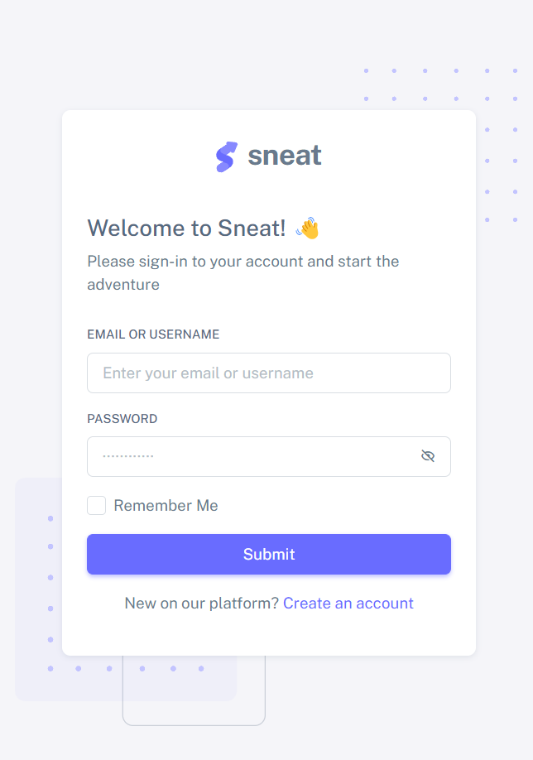
Major Functionality

Slide 8
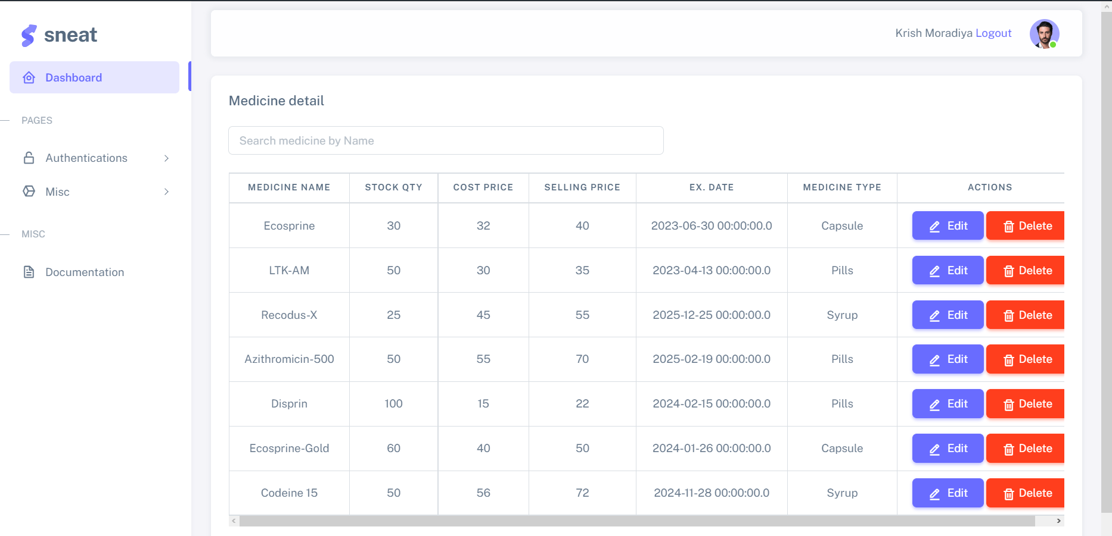

Slide 9
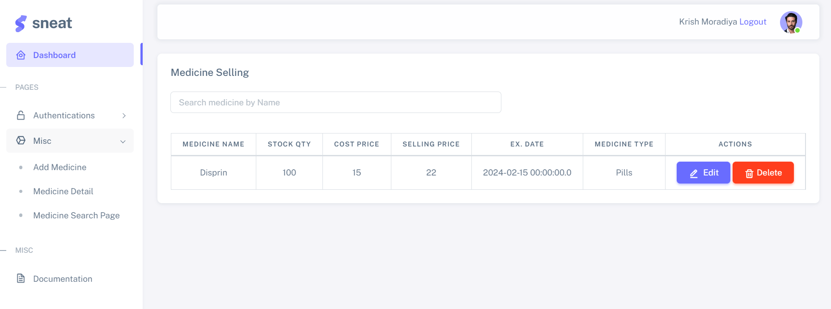

Slide 10
Feasibility study
A feasibility analysis involves a detailed assessment of the need, value and practicality of a proposed enterprise, such as systems development. The process of designing and implementing record keeping systems has significant accountability and resource implications for an organization. \
Technical feasibility
Technical feasibility is used to find out whether the necessary technology, the proposed equipment have the capacity to hold the capacity to hold the data, which is used in the project. It is a study of function, performance and constraints that may affect the ability to achieve an acceptance system.

Slide 11
Operational Feasibility
The proposed system offer greater level of user-friendly. The proposed system produces best results produces best results and give high performance. It can be implemented easily.
Economical Feasibility
Costs used to develop the system will be compensated with increased customer satisfaction and more frequent visits to the hospital and its pharmacy thus leading to more people buying medications from the hospital’s pharmacy

Slide 12
Limitations
Bill of the final product is not converted into the Pdf form to make a direct hard copy of the bill.
Managing the company of particular medicines is yet to manage.
Other products like Operational and surgical equipements are not mentioned in the list of the medicines.
Removing the meds which are already been expired is not done yet.

Slide 13
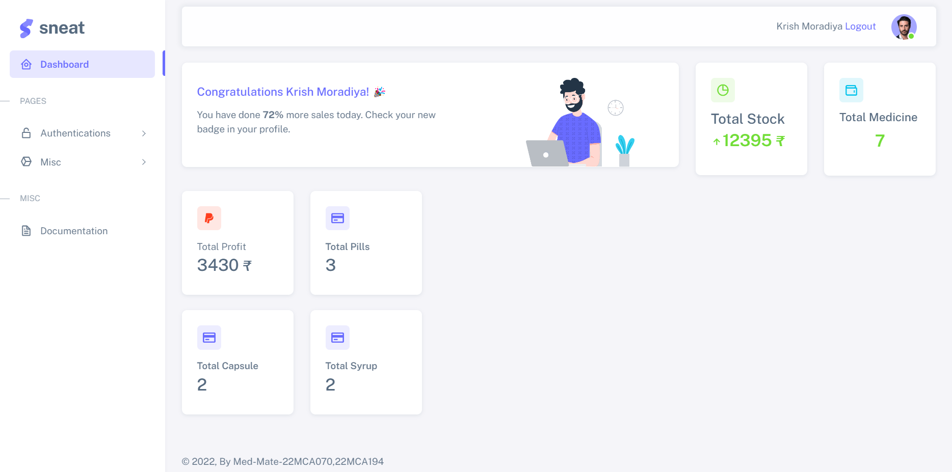
Outcome

Slide 14
Future Enhancement
Making Bill of the final product into the Pdf form to make a direct hard copy of the bill.
Managing the company of particular medicines .
Other products like Operational and surgical equipment's will be mentioned soon in the list of the medicines.
Removing the meds which are already been expired..

Slide 15
BIBLIOGRAPHY
Telusko – Naveen reddy
https://www.youtube.com/c/Telusko
Wikipedia
https://en.wikipedia.org/wiki/Pharmacy_management_system
Blogs
https://www.karexpert.com/blogs/what-are-the-challenges-faced-by-pharmacy-management-system/

Slide 16
Thank you

